Slide 1
Visualization and usage of Topic Modeling
Patrick Keller
Jeff Meder
Maya Olszewski

Slide 2
Index
Topic Modeling and Visualization
Related Work
Our Approach
Implementation
Demo
Future Work

Slide 3
Topic Modeling and Visualization
Topic Modeling
Unsupervised machine learning technique
Looks for relations in document collections
Growing amount of data -> need to visualize
Topic 1 Topic 2 Topic 3
Word
Cluster
Document 1
Document 2
Document N
…

Slide 4
Visualization
Visualization
Potential aid to better understand the relations
Concise and understandable representation of large data set
Intuitive

Slide 5
Related Work

Slide 6
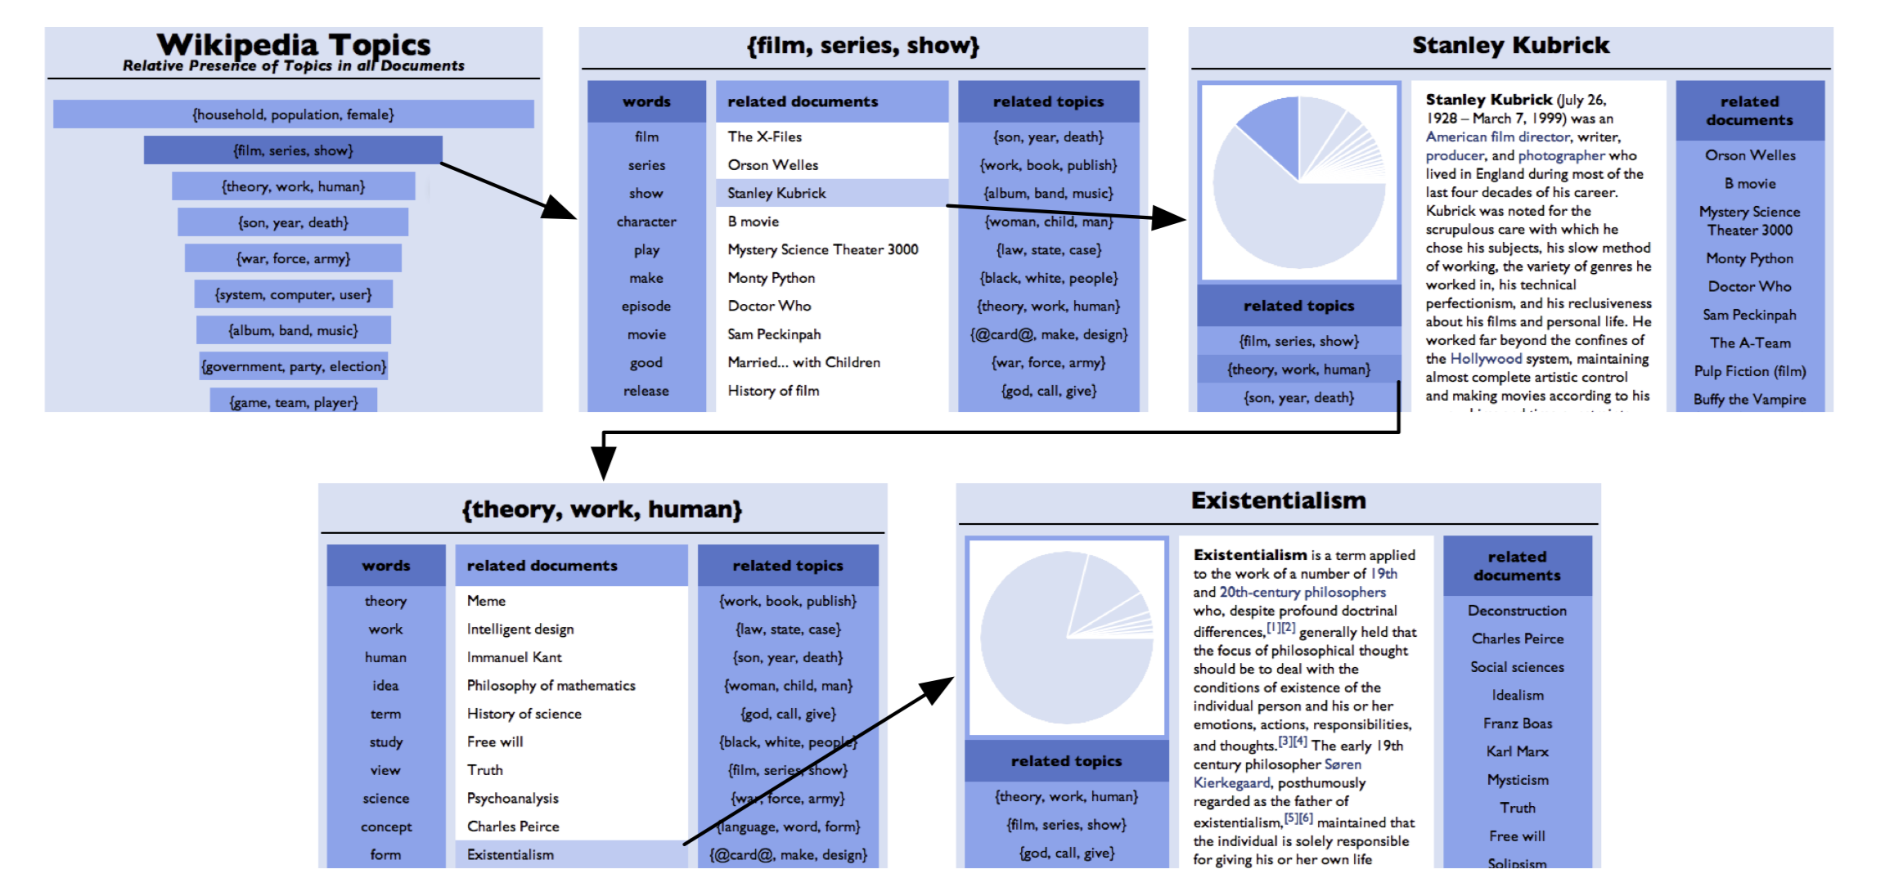

Slide 7
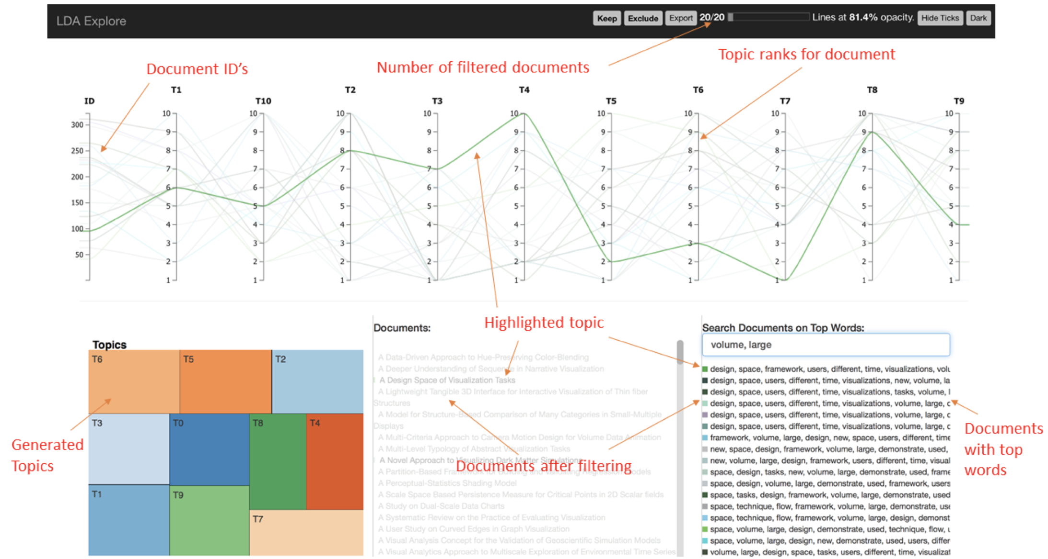

Slide 8
Our Approach

Slide 9
Implementation

Slide 10
Demo

Slide 11
Future Work

Slide 12
Questions?

